Slide 1
Computer Architecture and Assembly Language Programming

Slide 2
Architecture & Organization 1
Architecture is those attributes visible to the programmer
  Instruction set, number of bits used for data representation, I/O mechanisms, addressing techniques.
  e.g. Is there a multiply instruction?
Organization is how features are implemented
  Control signals, interfaces, memory technology.
  e.g. Is there a hardware multiply unit or is it done by repeated addition?
Dr. G. Sanjiv Rao Associate Professor, Department of CSIT & SE , AASTU.

Slide 3
Architecture & Organization 2
All Intel x86 family share the same basic architecture
The IBM System/370 family share the same basic architecture
This gives code compatibility
  At least backwards
Organization differs between different versions
Dr. G. Sanjiv Rao Associate Professor, Department of CSIT & SE , AASTU.

Slide 4
Structure & Function
Structure is the way in which components relate to each other
Function is the operation of individual components as part of the structure
Dr. G. Sanjiv Rao Associate Professor, Department of CSIT & SE , AASTU.

Slide 5
Function
All computer functions are:
  Data processing
  Data storage
  Data movement
  Control
Dr. G. Sanjiv Rao Associate Professor, Department of CSIT & SE , AASTU.

Slide 6

Functional View
Dr. G. Sanjiv Rao Associate Professor, Department of CSIT & SE , AASTU.

Slide 7

Operations (a) Data movement
Dr. G. Sanjiv Rao Associate Professor, Department of CSIT & SE , AASTU.

Slide 8
Operations (b) Storage
Dr. G. Sanjiv Rao Associate Professor, Department of CSIT & SE , AASTU.

Slide 9
Operation (c) Processing from/to storage
Dr. G. Sanjiv Rao Associate Professor, Department of CSIT & SE , AASTU.

Slide 10
Operation (d) Processing from storage to I/O
Dr. G. Sanjiv Rao Associate Professor, Department of CSIT & SE , AASTU.

Slide 11
Structure - Top Level
Peripherals
Computer
Central
Processing
Unit
Main
Memory
Computer
Systems
Interconnection
Input
Output
Communication
lines
Dr. G. Sanjiv Rao Associate Professor, Department of CSIT & SE , AASTU.

Slide 12
Structure - The CPU
CPU
Computer
Arithmetic
and
Login Unit
I/O
Registers
System
Bus
CPU
Internal CPU
Interconnection
Memory
Control
Unit
Dr. G. Sanjiv Rao Associate Professor, Department of CSIT & SE , AASTU.

Slide 13
Structure - The Control Unit
Control Unit
CPU
ALU
Sequencing
Login
Internal
Bus
Control
Unit
Control Unit
Registers and
Decoders
Registers
Control
Memory
Dr. G. Sanjiv Rao Associate Professor, Department of CSIT & SE , AASTU.

Slide 14
Computer Evolution and Performance
Dr. G. Sanjiv Rao Associate Professor, Department of CSIT & SE , AASTU.

Slide 15
ENIAC - background
Electronic Numerical Integrator And Computer
Eckert and Mauchly University of Pennsylvania
The Army’s Ballistics Research Laboratory (BRL), an agency responsible for developing range and trajectory tables for new weapons
Started 1943
Finished 1946
  Too late for war effort
Used until 1955 disassembled.
Dr. G. Sanjiv Rao Associate Professor, Department of CSIT & SE , AASTU.

Slide 16
ENIAC - details
Decimal (not binary)
20 accumulators of 10 digits
Programmed manually by switches
18,000 vacuum tubes
30 tons
15,000 square feet
140 kW power consumption
5,000 additions per second
Dr. G. Sanjiv Rao Associate Professor, Department of CSIT & SE , AASTU.

Slide 17
von Neumann/Turing
Stored Program concept
Main memory storing programs and data
ALU operating on binary data
Control unit interpreting instructions from memory and executing
Input and output equipment operated by control unit
Princeton Institute for Advanced Studies
  IAS
Completed 1952
Dr. G. Sanjiv Rao Associate Professor, Department of CSIT & SE , AASTU.

Slide 18

Structure of von Neumann machine
Dr. G. Sanjiv Rao Associate Professor, Department of CSIT & SE , AASTU.

Slide 19
IAS - details
1000 x 40 bit words
  Binary number
  2 x 20 bit instructions
Set of registers (storage in CPU)
  Memory Buffer Register
  Memory Address Register
  Instruction Register
  Instruction Buffer Register
  Program Counter
  Accumulator
  Multiplier Quotient
Dr. G. Sanjiv Rao Associate Professor, Department of CSIT & SE , AASTU.

Slide 20

Structure of IAS – detail
Dr. G. Sanjiv Rao Associate Professor, Department of CSIT & SE , AASTU.

Slide 21
Commercial Computers
1947 - Eckert-Mauchly Computer Corporation
UNIVAC I (Universal Automatic Computer)
US Bureau of Census 1950 calculations
Became part of Sperry-Rand Corporation
Late 1950s - UNIVAC II
  Faster
  More memory
Dr. G. Sanjiv Rao Associate Professor, Department of CSIT & SE , AASTU.

Slide 22
IBM
Punched-card processing equipment
1953 - the 701
  first electronic stored-program computer, the 701, in 1953
1955 - the 702
  Business applications
Lead to 700/7000 series
Dr. G. Sanjiv Rao Associate Professor, Department of CSIT & SE , AASTU.

Slide 23
Transistors
Replaced vacuum tubes
Smaller
Cheaper
Less heat dissipation
Solid State device
Made from Silicon (Sand)
Invented 1947 at Bell Labs
Dr. G. Sanjiv Rao Associate Professor, Department of CSIT & SE , AASTU.

Slide 24
Transistor Based Computers
Second generation machines
NCR & RCA produced small transistor machines
IBM 7000
(Digital Equipment Corporation) DEC - 1957
  Produced PDP-1
Dr. G. Sanjiv Rao Associate Professor, Department of CSIT & SE , AASTU.

Slide 25
Microelectronics
Literally - “small electronics”
A computer is made up of gates, memory cells and interconnections
These can be manufactured on a semiconductor
e.g. silicon wafer
Dr. G. Sanjiv Rao Associate Professor, Department of CSIT & SE , AASTU.

Slide 26
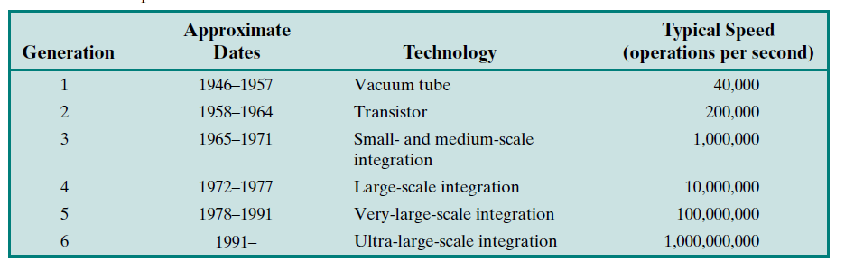
Generations of Computer
Dr. G. Sanjiv Rao Associate Professor, Department of CSIT & SE , AASTU.

Slide 27
Moore’s Law
Increased density of components on chip
Gordon Moore – co-founder of Intel
Number of transistors on a chip will double every year
Since 1970’s development has slowed a little
  Number of transistors doubles every 18 months
Cost of a chip has remained almost unchanged
Higher packing density means shorter electrical paths, giving higher performance
Smaller size gives increased flexibility
Reduced power and cooling requirements
Fewer interconnections increases reliability
Dr. G. Sanjiv Rao Associate Professor, Department of CSIT & SE , AASTU.

Slide 28
IBM 360 series
1964
Replaced (& not compatible with) 7000 series
First planned “family” of computers
  Similar or identical instruction sets
  Similar or identical O/S
  Increasing speed
  Increasing number of I/O ports (i.e. more terminals)
  Increased memory size
  Increased cost
Multiplexed switch structure
Dr. G. Sanjiv Rao Associate Professor, Department of CSIT & SE , AASTU.

Slide 29
DEC PDP-8
1964
First minicomputer (miniskirt!)
Did not need air conditioned room
Small enough to sit on a lab bench
$16,000
  $100k+ for IBM 360
Embedded applications
BUS STRUCTURE
Dr. G. Sanjiv Rao Associate Professor, Department of CSIT & SE , AASTU.

Slide 30
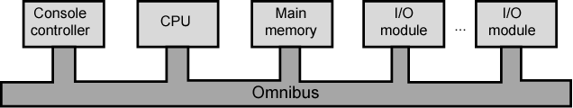
DEC - PDP-8 Bus Structure
Dr. G. Sanjiv Rao Associate Professor, Department of CSIT & SE , AASTU.

Slide 31
Semiconductor Memory
1970
Fairchild
Size of a single core
  i.e. 1 bit of magnetic core storage
Holds 256 bits
Non-destructive read
Much faster than core
Capacity approximately doubles each year
Dr. G. Sanjiv Rao Associate Professor, Department of CSIT & SE , AASTU.

Slide 32
Intel
1971 - 4004
  First microprocessor
  All CPU components on a single chip
  4 bit
Followed in 1972 by 8008
  8 bit
  Both designed for specific applications
1974 - 8080
  Intel’s first general purpose microprocessor
Dr. G. Sanjiv Rao Associate Professor, Department of CSIT & SE , AASTU.

Slide 33
Speeding it up
Pipelining
On board cache
On board L1 & L2 cache
Branch prediction
Data flow analysis
Speculative execution
Dr. G. Sanjiv Rao Associate Professor, Department of CSIT & SE , AASTU.

Slide 34
Performance Balance
Processor speed increased
Memory capacity increased
Memory speed lags behind processor speed
Dr. G. Sanjiv Rao Associate Professor, Department of CSIT & SE , AASTU.

Slide 35
Solutions
Increase number of bits retrieved at one time
  Make DRAM “wider” rather than “deeper”
Change DRAM interface
  Cache
Reduce frequency of memory access
  More complex cache and cache on chip
Increase interconnection bandwidth
  High speed buses
  Hierarchy of buses
Dr. G. Sanjiv Rao Associate Professor, Department of CSIT & SE , AASTU.

Slide 36
I/O Devices
Peripherals with intensive I/O demands
Large data throughput demands
Processors can handle this
Problem moving data
Solutions:
  Caching
  Buffering
  Higher-speed interconnection buses
  More elaborate bus structures
  Multiple-processor configurations
Dr. G. Sanjiv Rao Associate Professor, Department of CSIT & SE , AASTU.

Slide 37
Key is Balance
Processor components
Main memory
I/O devices
Interconnection structures
Dr. G. Sanjiv Rao Associate Professor, Department of CSIT & SE , AASTU.

Slide 38
Improvements in Chip Organization and Architecture
Increase hardware speed of processor
  Fundamentally due to shrinking logic gate size
    More gates, packed more tightly, increasing clock rate
    Propagation time for signals reduced
Increase size and speed of caches
  Dedicating part of processor chip
    Cache access times drop significantly
Change processor organization and architecture
  Increase effective speed of execution
  Parallelism
Dr. G. Sanjiv Rao Associate Professor, Department of CSIT & SE , AASTU.

Slide 39
Increased Cache Capacity
Typically two or three levels of cache between processor and main memory
Chip density increased
  More cache memory on chip
    Faster cache access
Pentium chip devoted about 10% of chip area to cache
Pentium 4 devotes about 50%
Dr. G. Sanjiv Rao Associate Professor, Department of CSIT & SE , AASTU.

Slide 40
More Complex Execution Logic
Enable parallel execution of instructions
Pipeline works like assembly line
  Different stages of execution of different instructions at same time along pipeline
Superscalar allows multiple pipelines within single processor
  Instructions that do not depend on one another can be executed in parallel
Dr. G. Sanjiv Rao Associate Professor, Department of CSIT & SE , AASTU.

Slide 41
New Approach – Multiple Cores
Multiple processors on single chip
  Large shared cache
Within a processor, increase in performance proportional to square root of increase in complexity
If software can use multiple processors, doubling number of processors almost doubles performance
So, use two simpler processors on the chip rather than one more complex processor
With two processors, larger caches are justified
  Power consumption of memory logic less than processing logic
Dr. G. Sanjiv Rao Associate Professor, Department of CSIT & SE , AASTU.

Slide 42
x86 Evolution (1)
8080
  first general purpose microprocessor
  8 bit data path
  Used in first personal computer – Altair
8086 – 5MHz – 29,000 transistors
  much more powerful
  16 bit
  instruction cache, prefetch few instructions
  8088 (8 bit external bus) used in first IBM PC
80286
  16 Mbyte memory addressable
  up from 1Mb
80386
  32 bit
  Support for multitasking
80486
  sophisticated powerful cache and instruction pipelining
  built in maths co-processor
Dr. G. Sanjiv Rao Associate Professor, Department of CSIT & SE , AASTU.

Slide 43
x86 Evolution (2)
Pentium
  Superscalar
  Multiple instructions executed in parallel
Pentium Pro
  Increased superscalar organization
  Aggressive register renaming
  branch prediction
  data flow analysis
  speculative execution
Pentium II
  MMX technology
  graphics, video & audio processing
Pentium III
  Additional floating point instructions for 3D graphics
Dr. G. Sanjiv Rao Associate Professor, Department of CSIT & SE , AASTU.

Slide 44
x86 Evolution (3)
Pentium 4
  Note Arabic rather than Roman numerals
  Further floating point and multimedia enhancements
Core
  First x86 with dual core
Core 2
  64 bit architecture
Core 2 Quad – 3GHz – 820 million transistors
  Four processors on chip
x86 architecture dominant outside embedded systems
Organization and technology changed dramatically
Instruction set architecture evolved with backwards compatibility
~1 instruction per month added
500 instructions available
See Intel web pages for detailed information on processors
Dr. G. Sanjiv Rao Associate Professor, Department of CSIT & SE , AASTU.

Slide 45
Embedded Systems ARM
ARM evolved from RISC design
Used mainly in embedded systems
  Used within product
  Not general purpose computer
  Dedicated function
  E.g. Anti-lock brakes in car
Dr. G. Sanjiv Rao Associate Professor, Department of CSIT & SE , AASTU.

Slide 46
Embedded Systems Requirements
Different sizes
  Different constraints, optimization, reuse
Different requirements
  Safety, reliability, real-time, flexibility, legislation
  Lifespan
  Environmental conditions
  Static v dynamic loads
  Slow to fast speeds
  Computation v I/O intensive
  Descrete event v continuous dynamics
Dr. G. Sanjiv Rao Associate Professor, Department of CSIT & SE , AASTU.

Slide 47
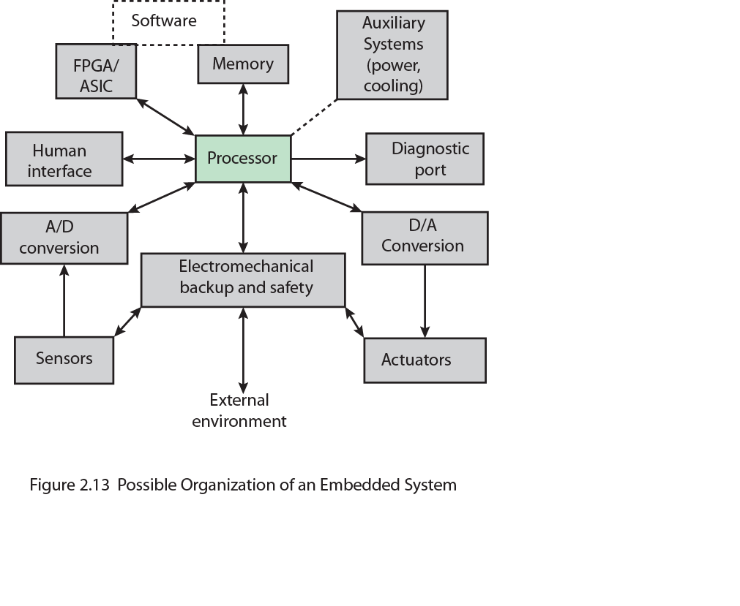
Possible Organization of an Embedded System
Dr. G. Sanjiv Rao Associate Professor, Department of CSIT & SE , AASTU.

Slide 48
ARM Evolution
Designed by ARM Inc., Cambridge, England
Licensed to manufacturers
High speed, small die, low power consumption
PDAs, hand held games, phones
  E.g. iPod, iPhone
Acorn produced ARM1 & ARM2 in 1985 and ARM3 in 1989
Acorn, VLSI and Apple Computer founded ARM Ltd.
Dr. G. Sanjiv Rao Associate Professor, Department of CSIT & SE , AASTU.

Slide 49
ARM Systems Categories
Embedded real time
Application platform
  Linux, Palm OS, Symbian OS, Windows mobile
Secure applications
Dr. G. Sanjiv Rao Associate Professor, Department of CSIT & SE , AASTU.

Slide 50
Instruction Execution Rate
Millions of instructions per second (MIPS)
Millions of floating point instructions per second (MFLOPS)
Heavily dependent on instruction set, compiler design, processor implementation, cache & memory hierarchy
Dr. G. Sanjiv Rao Associate Professor, Department of CSIT & SE , AASTU.

